Slide 1
Fraud Detection Project
for Xente Tech Ltd. in The Innovation Village, Uganda
05. January 2023
Paul, Tobi and Reebal

Slide 2
Table of content
Who is Xente?
Our Mission
Data Work & Baseline Model
Machine learning work easy explained
Outline findings
Recommendation and future work

Slide 3
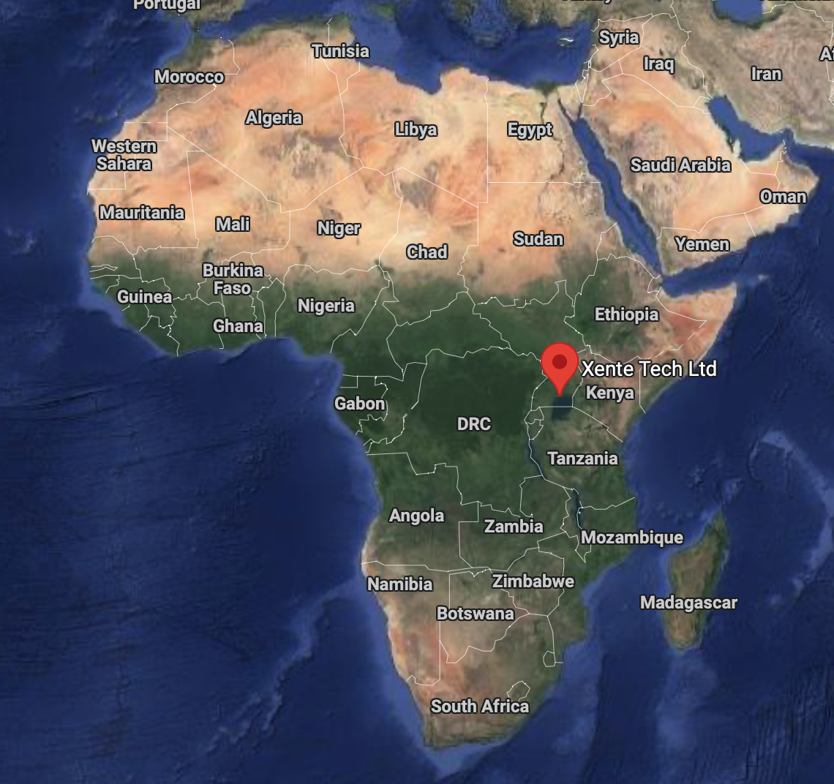

Who is Xente?
Xente is a Financial Technology company based in Uganda
Focus on:
small payments (team members, airtime, utilities)
finance automation for companies
expense management (documentation for accounting)
(corporate) Visa cards
mobile money, bank transfers, credit

Slide 4
Why Xente?
Xente makes African businesses efficient, empowers them to grow and connects them to the global economy
Fraud detection is a relevant subject to every business in the world
Fraud detection could also be a service of Xente

Slide 5

Our Mission
Build a model that can detect frauds
Data work
Baseline modell
Predictive Modeling
Visualization

Slide 6

Data work
Features: 19
Transactions: 95.662
Data cleaning
Data exploration
Feature engineering

Slide 7
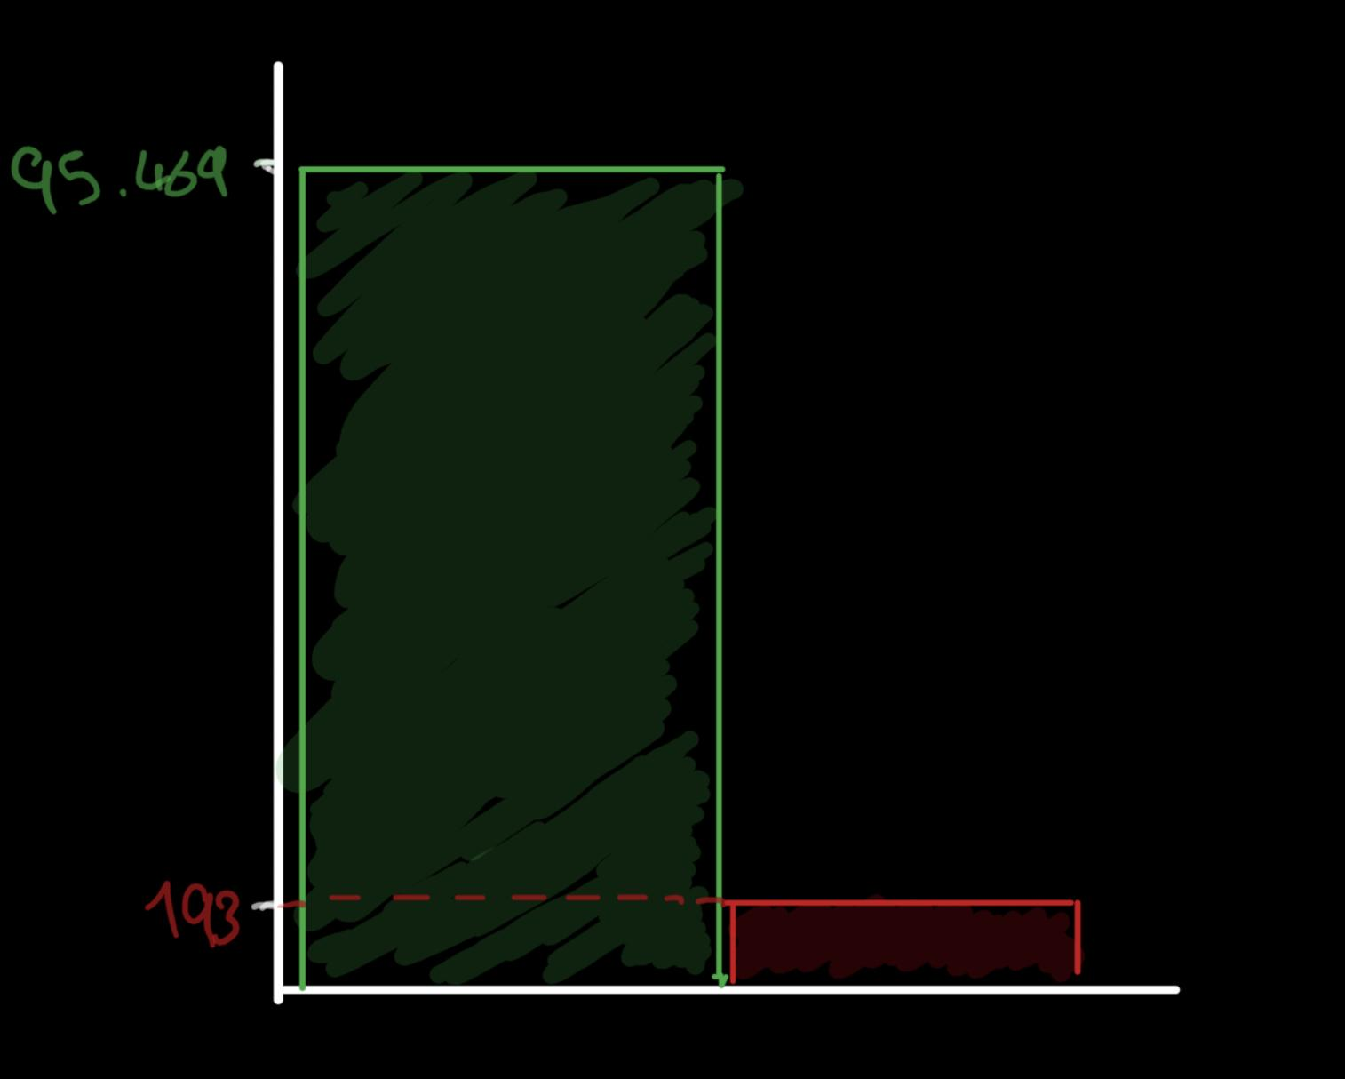
Fraud Cases
0.2% Frauds
X: Frauds, Non-frauds y: Number of cases
Non-frauds Frauds

Slide 8

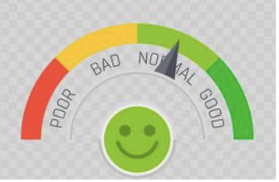
Baseline Modell
Transactions with an value equal or exceeding 500.000 are frauds.
f1-score = 0.78

Slide 9
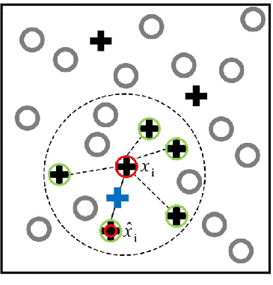
Machine learning
The problem: imbalance
The solution: Synthetic Minority Oversampling Technique
The model: Building three different models
Tuning: From good to great through hyperparameter tuning
creating synthetic frauds using SMOTE

Slide 10
Results
Unoptimized model: F1-score 0.79
Optimized model: F1-score 0.88
Most important features:
transactions in financial services (products and providers) are most likely to be fraudulent

Slide 11
Recommendation & future work
Improve model:
collect more data and improve model
cost of missed frauds vs. wrongly predicted frauds
error analysis
Further preventive measures:
two factor authentification

Slide 12
Thank You
Questions?

